Slide 1
Martin Bailey (Director – Animate 2 Educate Ltd)
Web: www.animate2educate.co.uk
E-mail: martinbailey@animate2educate.co.uk
Facebook: facebook.com/animate2educate
Twitter: @animate2educate
Mr Bailey is a visionary for how ICT can be used creatively to motivate, stimulate and raise standards.
Nick Anderson (Headteacher - Bede Community Primary School, Gateshead)

Slide 2
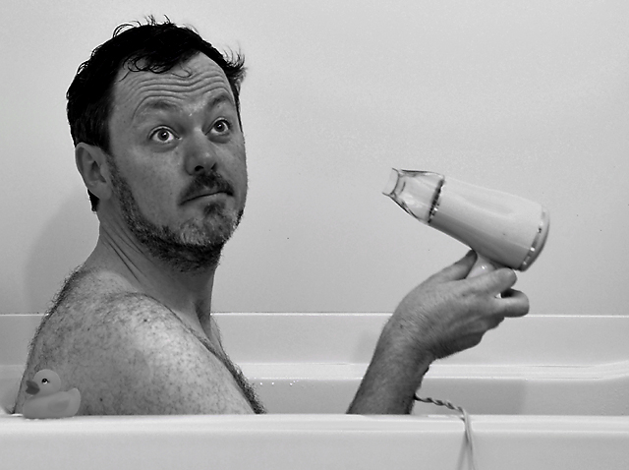

Slide 3
Filtering is NOT the answer. We need to teach our children what to do when they find something offensive.
Children need to develop a good attitude to communicating online and acquire a safe and responsible set of online behaviours.

Slide 4
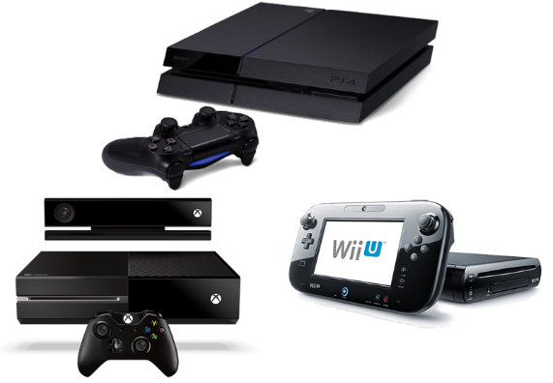
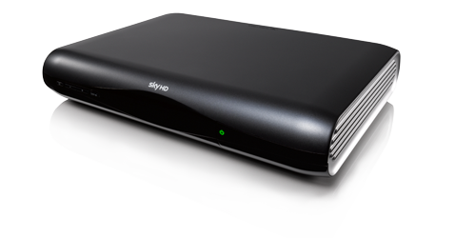

Slide 5
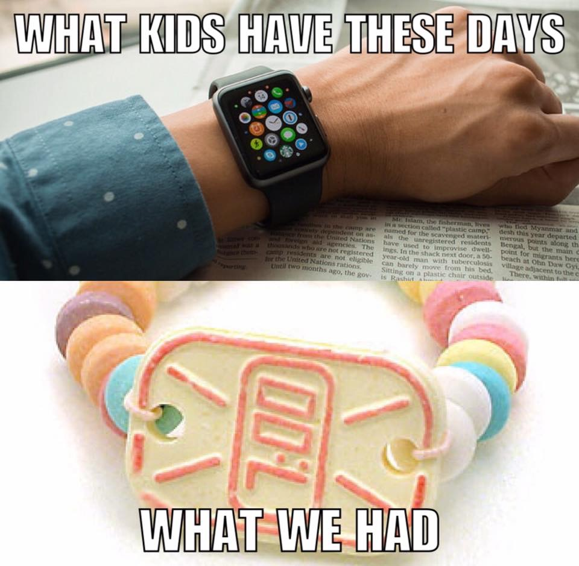

Slide 6
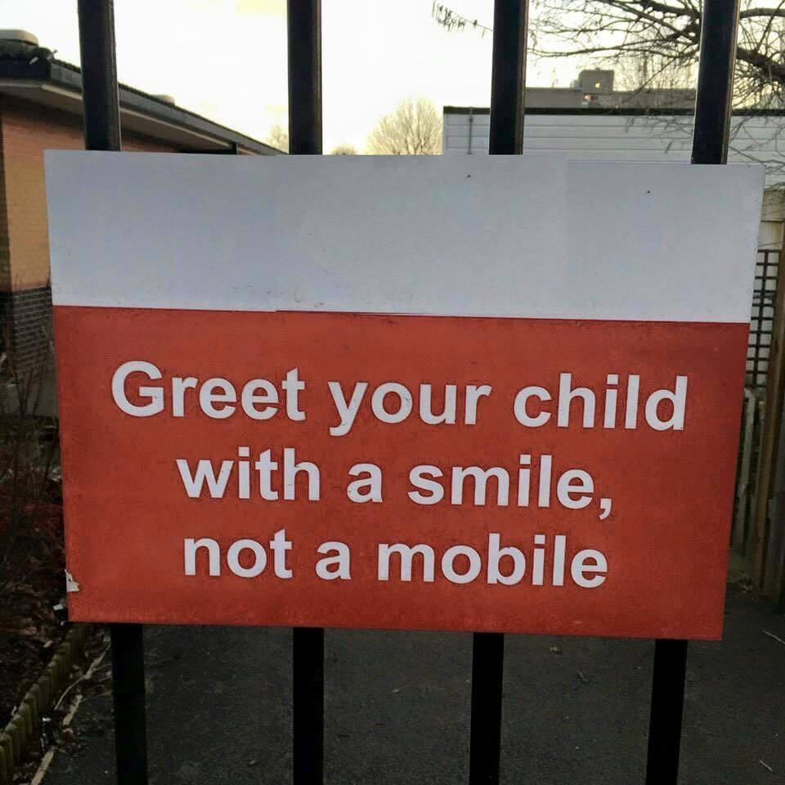

Slide 7
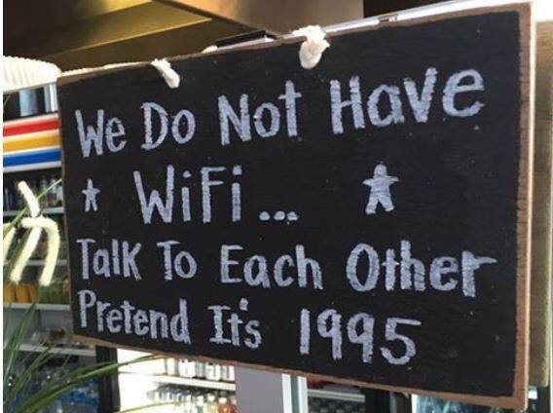

Slide 9
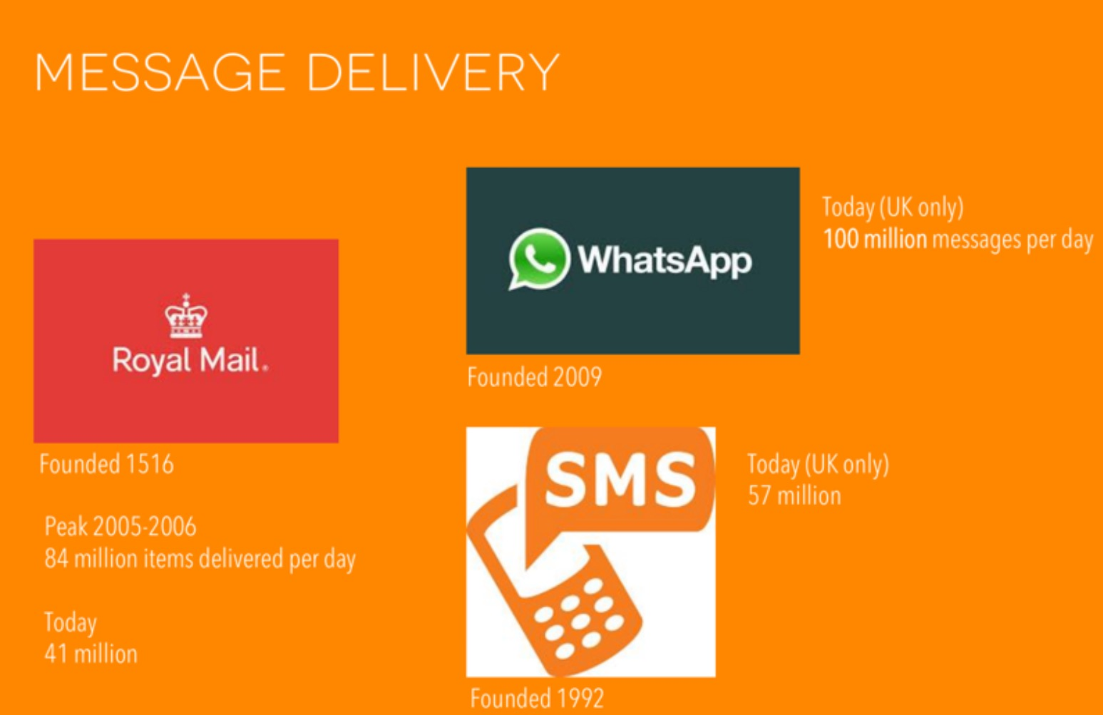
* 2014 statistics

Slide 12
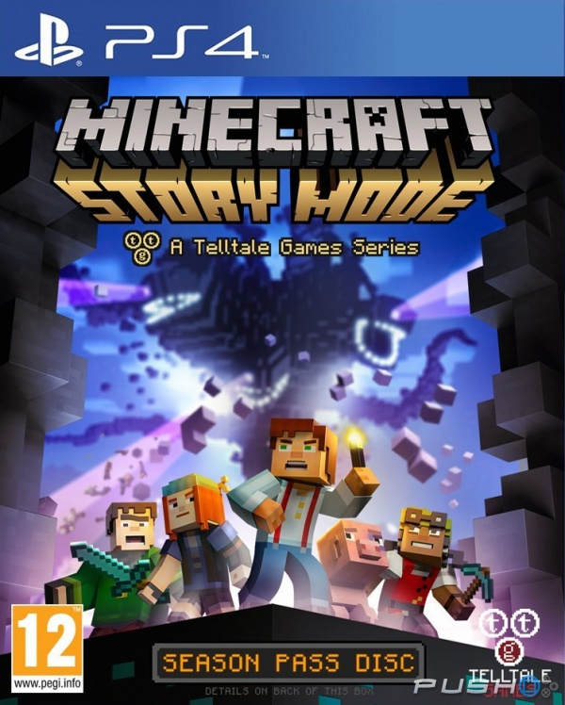

Slide 13
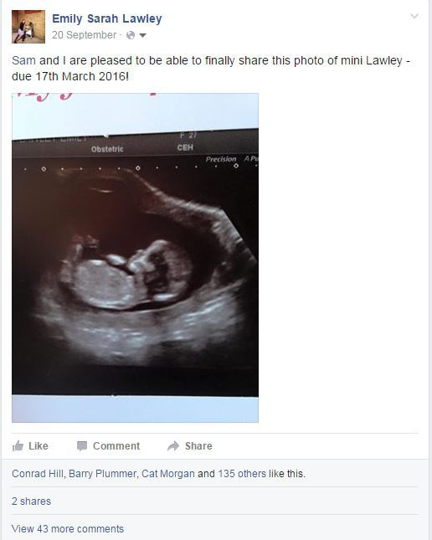

Slide 16
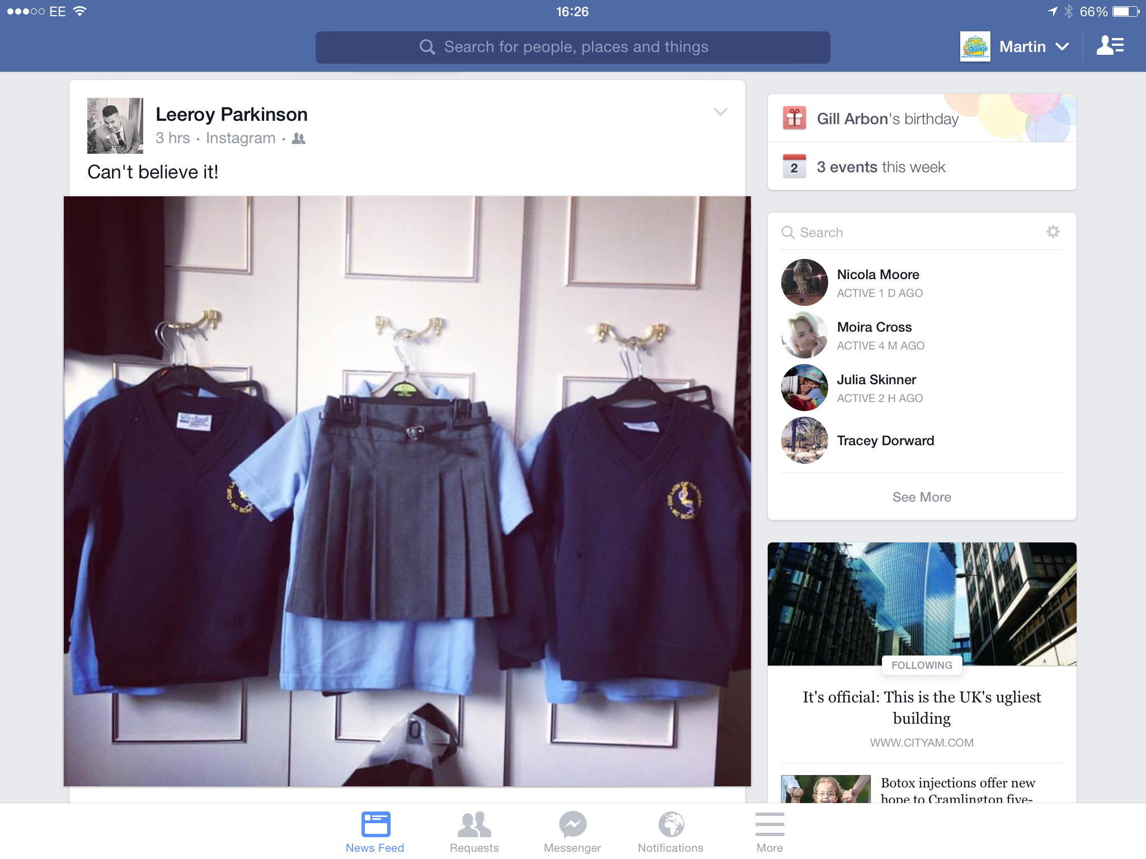
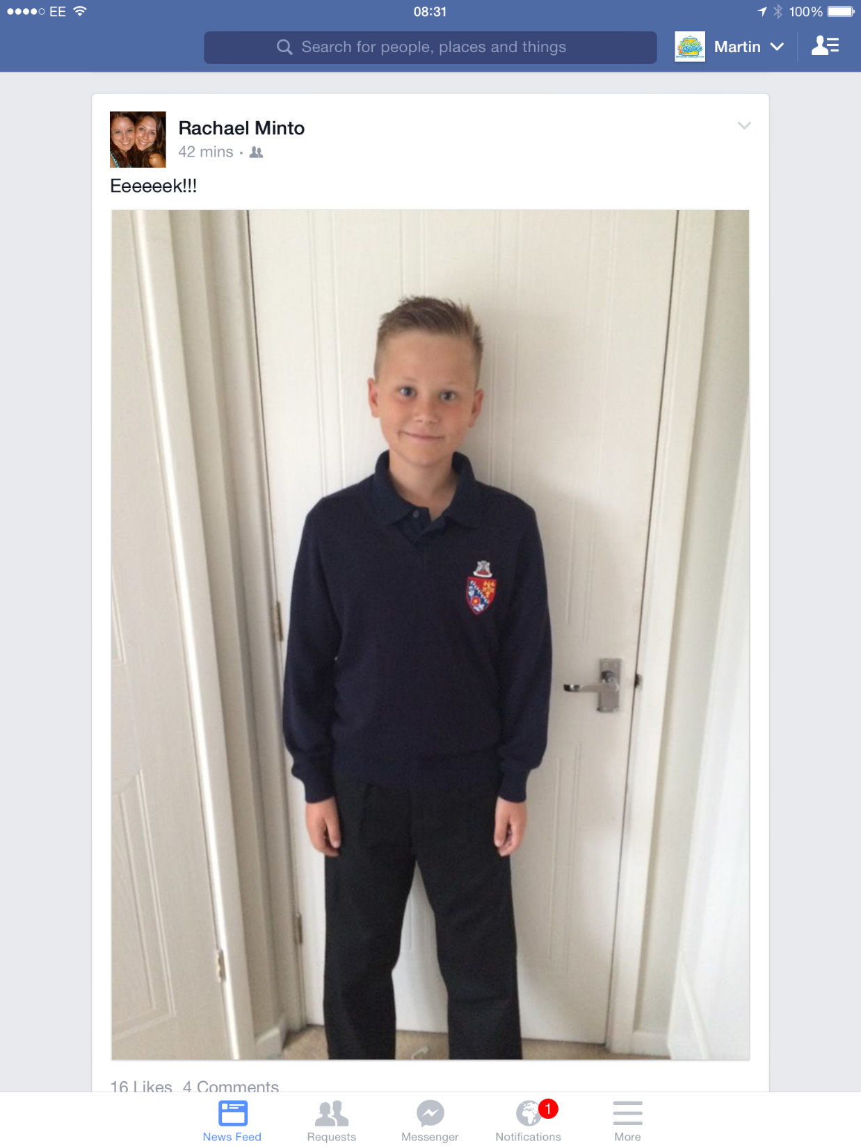

Slide 17
@LanchesterEP

Slide 18
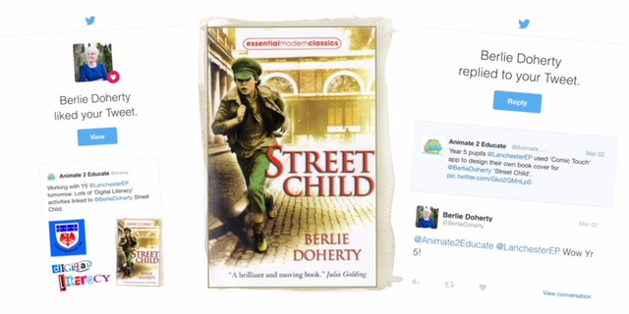

Slide 19
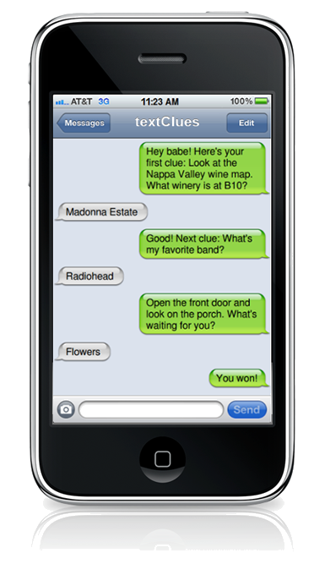

Slide 21
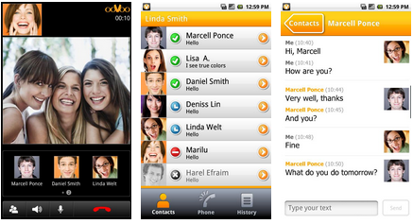
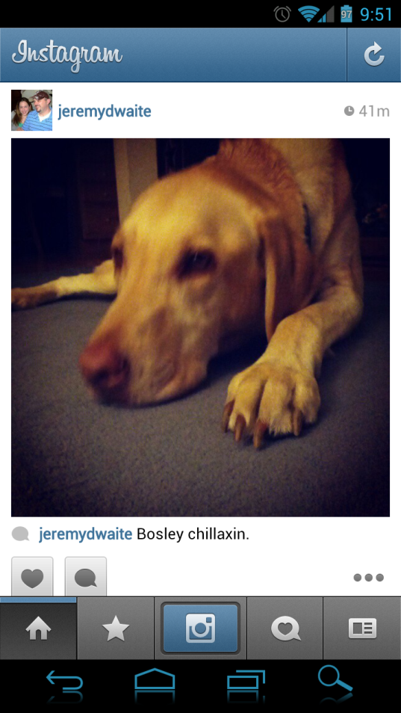
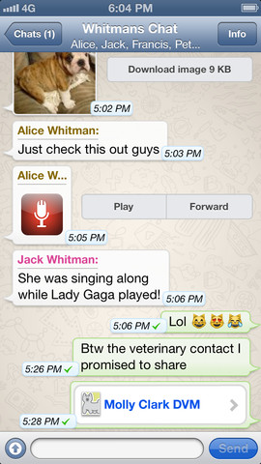
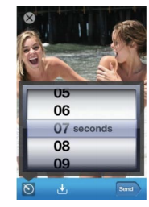
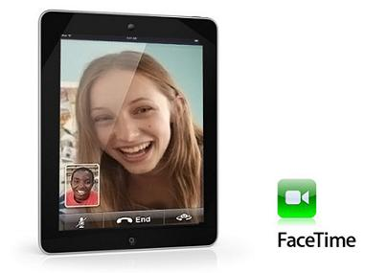

Slide 23
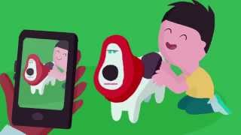

Slide 24
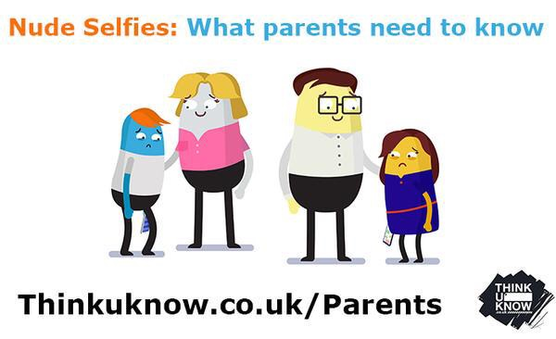

Slide 25
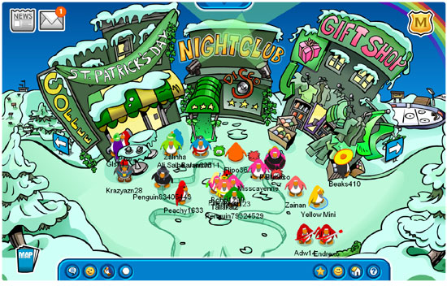

Slide 26
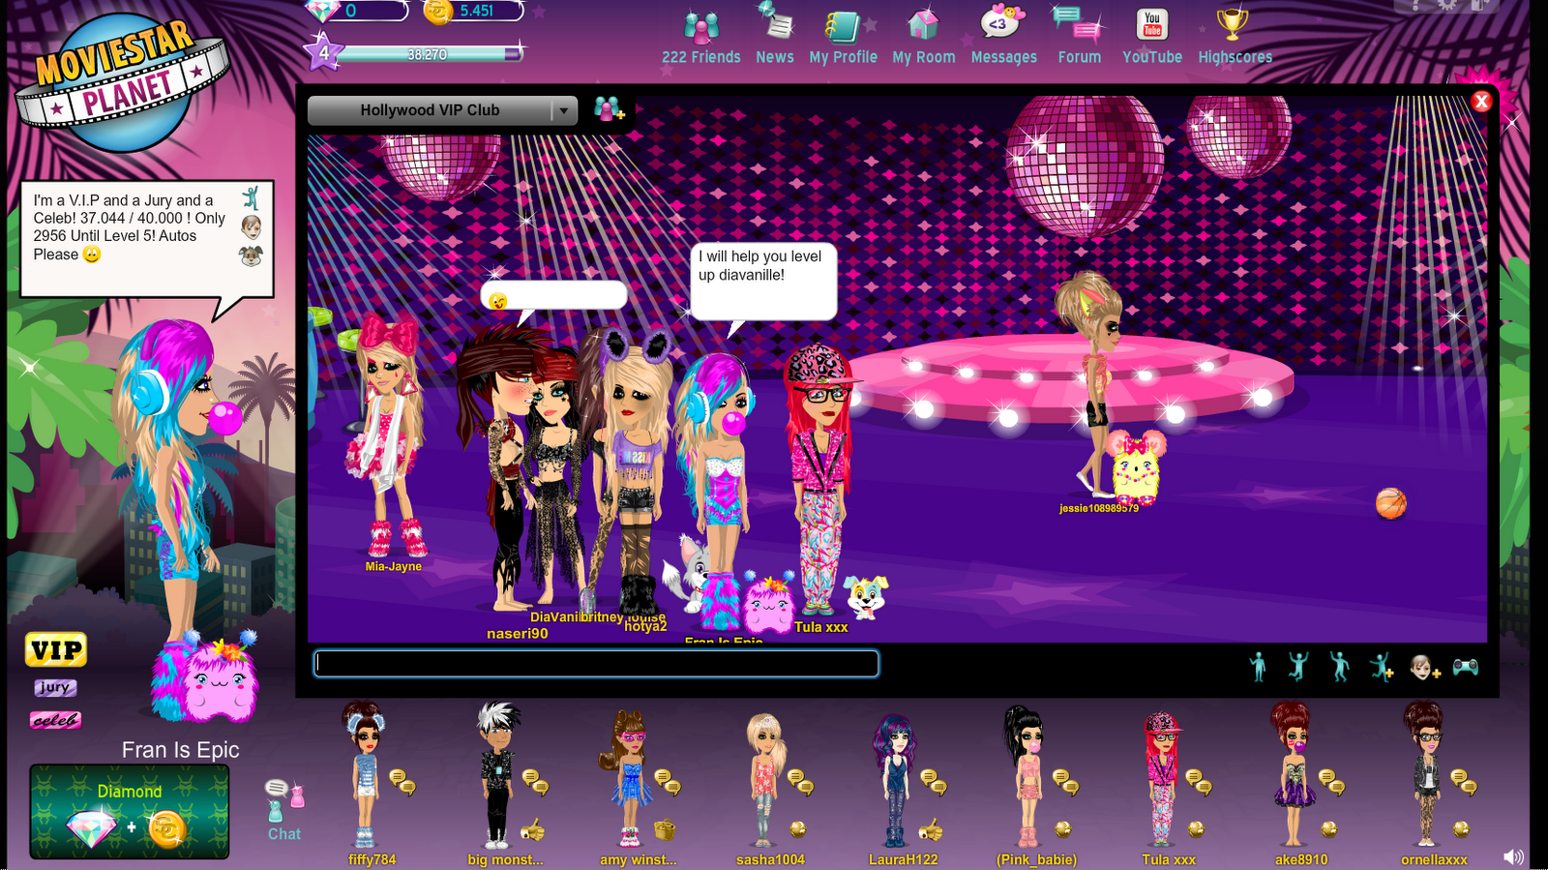

Slide 27
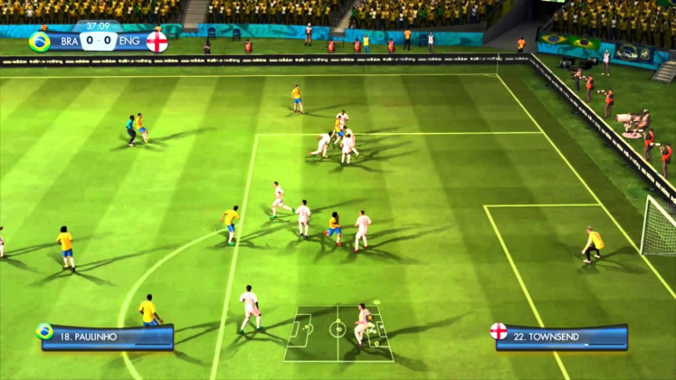

Slide 28
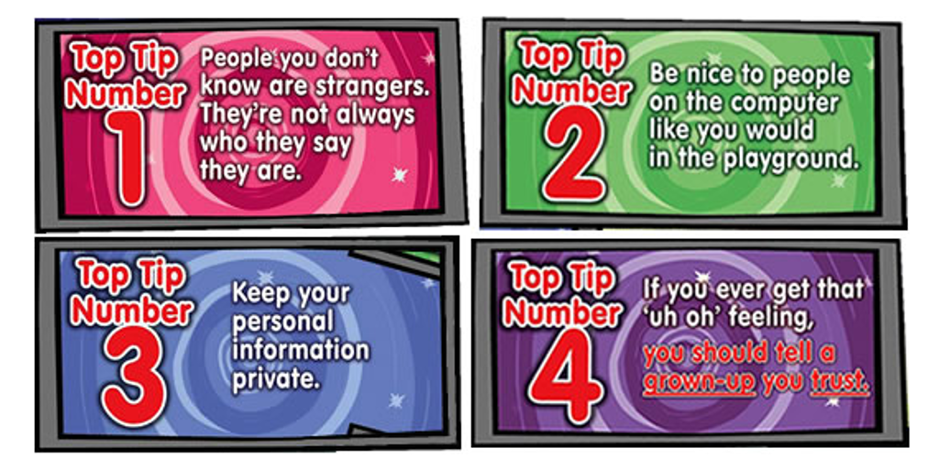
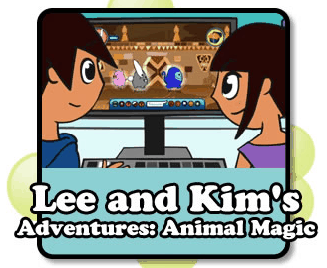

Slide 31
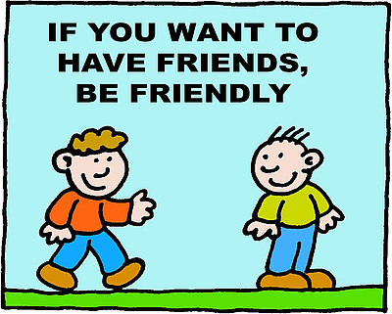

Slide 32
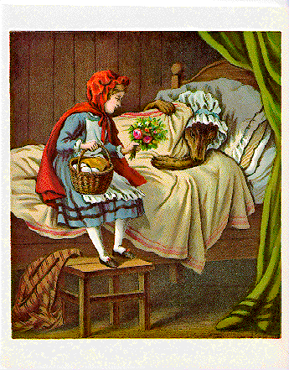

Slide 33
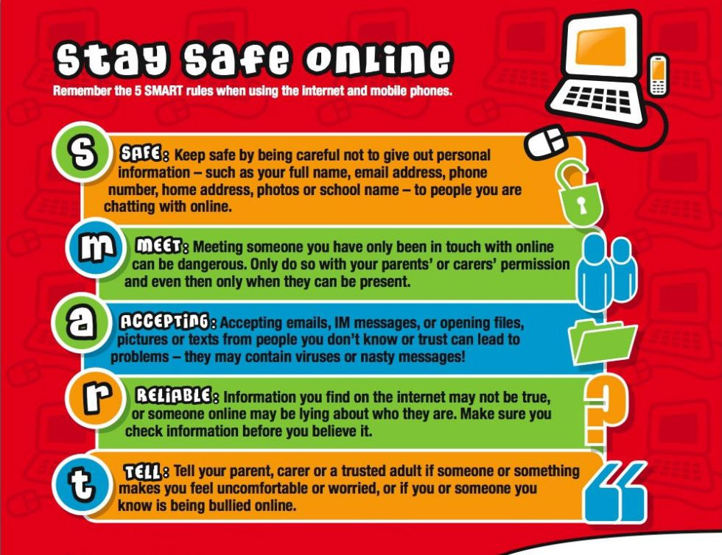

Slide 34
Martin Bailey (Director – Animate 2 Educate Ltd)
Web: www.animate2educate.co.uk
e-mail: martinbailey@animate2educate.co.uk
Facebook: facebook.com/animate2educate
Twitter: @animate2educate

